Slide 1
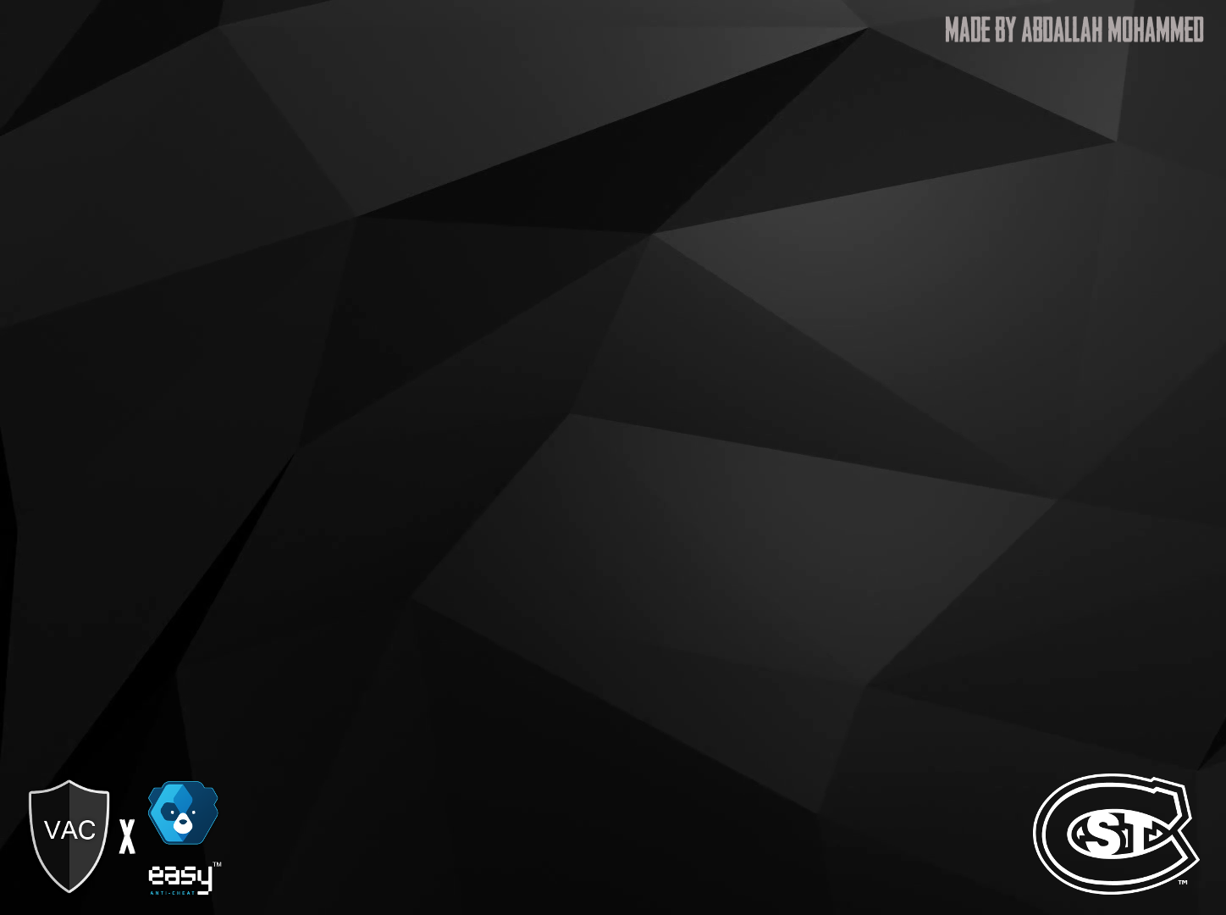
The Effects of Cheats in Anti-Cheat Protected Servers/Games
By: Abdallah Mohammed
20 June 2019
IA 680
Dr. Susantha Herath

Slide 2
Abstract
Within the realm of online competitive videogames, there are bound to be cheaters.
There are groups of individuals out there who constantly discover and dig for ways to gain an unfair advantage in online play.
The cheaters look for an upper hand over the other players by:
Having a steadier aim, seeing things others cannot, infinite ammunition, or misusing a bug that leads them to being invincible.
Online games have an Anti-Cheat software in place to protect the server against cheaters, but how secure is it. The main objective of the paper is to identify key scenarios into what a user recognizes and experiences in terms of being exposed to cheats, to possibly aid in the creations of a more secure Anti-Cheat software for developing existing/future studios.

Slide 3
Introduction
The definition of cheating is the act dishonestly or unfairly in order to gain an advantage, mostly existent within a game or during an examination. The idea of cheating was invariably existent in competitive sports, that could be a game of poker, golf or a game of Quidditch. Most often, cheating is present where there is a prize at stake.
The previously mentioned examples mostly fall under offline cheating. In today's era, there exists online cheating, where the contrast is notable. In the real world of offline cheating, the repercussion for such an act of cheating has been in place from the beginning of time, and the laws that regulate cheating are tactile.
Notes:
Quidditch: The sport played in J.K Rolwing’s novel, Harry Potter.

Slide 4
Introduction (Cont.)
Meanwhile, in the online world, it is fairly new and lacking most of the regulations from the offline world. The obscurity factor is a big reason why many tend to do the heinous act. On top of that, cheating in the online world is becoming more straightforward to do, with scripts deployed in just a button-click away. Availability of cheat software are increasing by the day. Resulting in honest players having a bad experience and distaste from a lobby where a cheater takes over.

Slide 5
Background
Cheating comes in many forms within the online world. In order to put cheating in to play, a spectrum is cheated with four aspects of cheating is covered.
The first being, Exploitations. Which is the least of worry from the spectrum. By definition, an Exploit is the use of a bug or glitch by a player to their own advantage in a manner that is not intended by the game developer
Examples of Exploitation cheats include: duping, twinking, safe zone abuse, pixel walking and different instance of cheesing.
Typically, an exploitation is not a matter to stress about, until monetary incentives are involved.
…

Slide 6
Background (Cont.)
The second in the spectrum being Automation. This is mostly acceptable in single-player games that are grind-heavy. But in games with competitive aspects to it, this is taken very seriously.
Examples of Automation cheats include: Aim-bot, Trigger-bot, Macroing, Botting or processes related to a sequence of repetitive key or button presses.

Slide 7
Background (Cont.)
Third being Overlays, which are cheats that display data about the location of other users, items, health or any type of status in a game world. This is very sensitive information that is can make a huge different in competitive play. It is as if being able to see an opponent’s hand in a game of poker.
Examples of Overlay cheats include: Chameleonhack, Inventory Info or ESP.
The fourth and last is State Manipulations (S.M.), these are the most obvious and dangerous type of cheat. Since it is obvious, these are not likely to happen in a competitive environment but common in normal matchmaking
Examples of S.M. cheats include: Teleportation hacks, Speedhack, Noclip or anything applicable to changing values of a user.

Slide 8
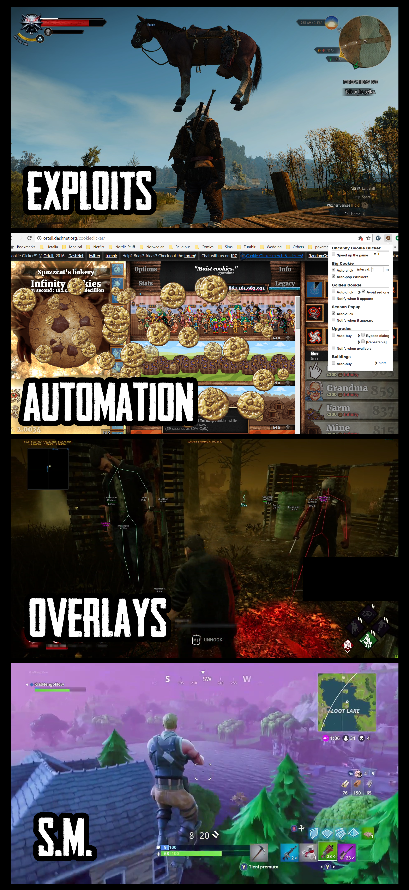
Fig. 1. Cheat Spectrum

Slide 9
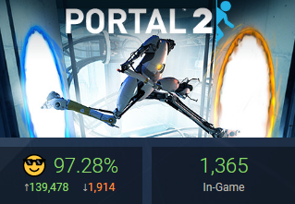
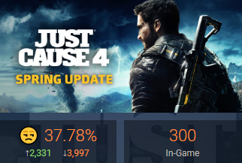
The Importance of User Experience
Predominantly, a game's experience is shaped around the player. In order for a game developing studio or publisher to make any revenue, the player's retention rate is crucial, and that is judged by player's experience within the game environment. So, the target is to receive positive reviews about a game.
Fig. 2. Valve’s Portal 2, Reviews.
Fig. 3. Avalanche Studios’
Just Cause 4, Reviews.
Notes:
Figure 2 shows the game Portal 2, published and developed by Valve. The statistics show that there are 139,478 positive reviews and only 1,914 negative reviews, with a 97.28% overall. This is the most top-rated online game on the Steam platform [REF], with 1,365 active players despite being released in 2011.

Slide 10
Main Terminologies
It is integral to understand three terms before proceeding with the experiment. The terms define the roles that act in decreasing the enjoyment of most player experience and/or the game design of a game developing studio/publisher. This part of the paper will cover the origin of each role, the potency, as well as the ease of access of said roles.
“Hacker” –– this actor creates the main feature in which the software is used for, they also discover injection techniques to bypass the existing Anti-Cheat system and get the hack running into the game’s official servers. They also are behind the Research and Development phase for the cheats.
“Provider” –– this actor acts as the man-in-the-middle between the hacker and cheater. They oversee the distribution phase. Providers handle the marketing and branding of the cheat scripts, as well as, taking on the role of community manager and payment gateways. Generally, well-branded providers localize their presence and expand their reach to potential cheaters.
“Cheater” –– this actor is the consumer and user. They are the ones who act on the game environment and use the software supplied by the hackers.

Slide 11
Hacker Role
Three different profiles can be identified within a hacker role.
Starting from the most common type, the scripters. They make up most of the hackers. Since we mentioned earlier that they are behind the Research and Development of cheats, they often wait for game updates so they can dissect the game files in order to create scripts for easy-to-use cheats.
Moving on to the senior-hackers, they are more experienced and go on to creating commercialized cheats that are feature-rich and expensive. It is common for senior-hackers to have a history in the software engineering field.
The last type of hacker is the researchers, usual work in teams to reverse engineer a game using a handful of tools and software. The main different between a senior-hacker and a researcher is that a researcher's focus is to publish a proof of concept as a real researcher would do.

Slide 12
Cheater Role
Cheaters come in different profiles as well. The most popular being the griefers. They are cheaters who derive pleasure primarily or exclusively from the act of annoying other users. Since they do not seek glory, they are usually discouraged by in-game penalties, such as a ban from the server.
Next profile would be the casual-cheaters, who would like to make the game a more pleasant experience for themselves. Their intention is not to spoil the other players' experiences, but it usually ends up with negative feedback from the rest of the lobby. It goes like the saying, "Once a cheater, always a cheater."
Following up to the casual-cheaters are the achievers. They are cheaters who would like to reap all the glory and come out victorious in competitive play without the repercussions of getting caught in doing so.

Slide 13
Cheater Role (Cont.)
Finally, the last profile is often referred to as the vigilantes. They are the casual players that often end up becoming a victim to cheats, then proceeding to search the web for a script in order to seek vengeance for the unpleasant experience that occurred to them. The background of player who end up becoming a vigilante, come from a high level of loyalty to the developers of the game. Vigilantes feel the need to cheat so make the environment even.
Towards the end of the paper, there will suggestions, from the users who filled the questionnaire, for how an Anti-Cheat software to improve in order to improve protection. As a side note, it is important to differentiate these cheaters since some of them need to be blacklisted from the official servers for good; While others, would need to be in a protected server and given a consistent pleasant experience to be not have any vigilante tendencies.

Slide 14
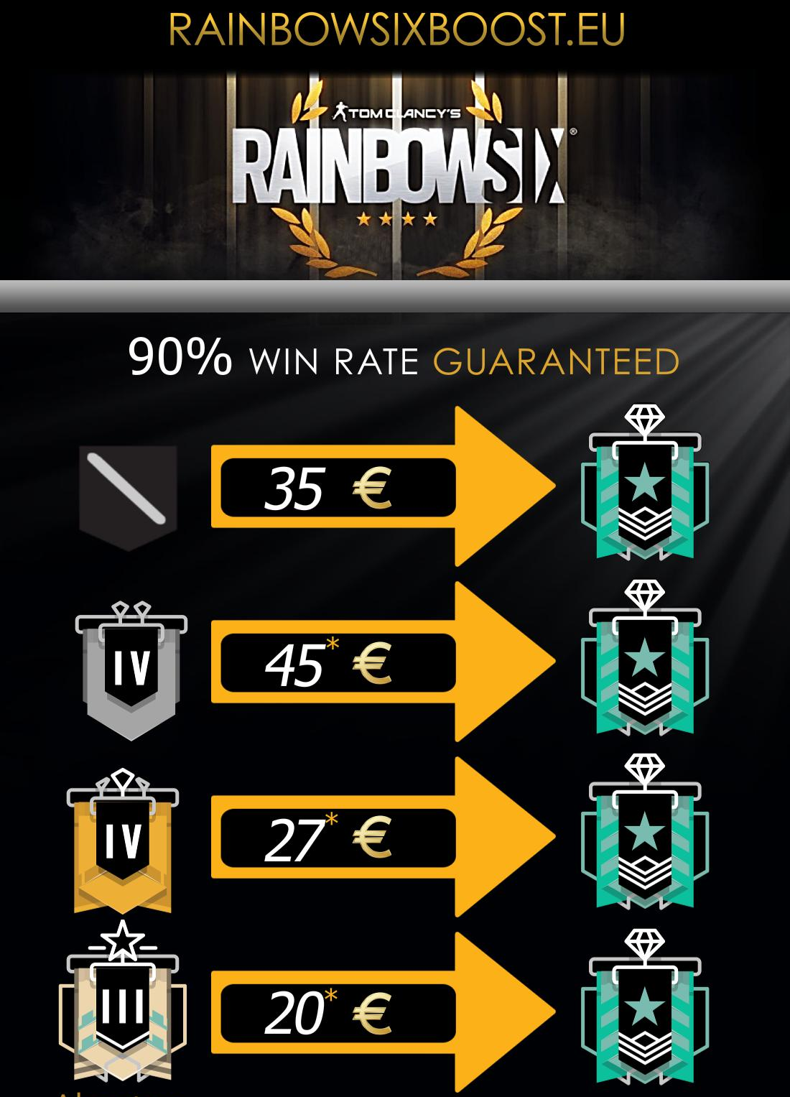
Provider Role
The last role, certainly making it easy for cheaters to find hacks are the providers. There are three methods of acquiring cheats from the providers.
The most advertised and easiest way to find free cheats are from the open-communities. These communities a common ground for beginner-level hackers to learn how things work in the cheat world. Registered users can also become approved sellers and offer some cheat or a server for a price. Below is an example of a rank boosting service offered by a member in the MPGH open-community.
Fig. 4. An example of a service offered by the user CopyrightWalrus.

Slide 15
Provider Role (Cont.)
Next comes the cheat-publishers that advertise and commercialize paid cheats for the end user. Their websites are just an easy to find as the open-community ones. Cheat-publishers can take any type of payment gateway from Venmo to Crypto. There are many of them across the web, one popular one is AIMWARE.
The final type of cheater provider is the closed-communities. They are tough to get in since they are strictly invite-only based on reputation, a vouch from an existing trusted member or an infamous positive reputation from other communities. Most of the cheats within a closed-community are in limited runs with a set number of buyer space. In some cases of closed-communities, there are very exclusive cheats where users would pay over $2500 dollars to get a custom cheat tailored to their liking and utterly undetectable by the respected Anti-Cheat software.

Slide 16
Literature Review
To further understand the research being conducted, as well as, finding two functional cheats to conduct the experiment in the later stage of this paper, a popular competitive game where a notorious Anti-Cheat system is present must be found; Alongside a provider offering a cheat to it.
Being familiar with the competitive games already, the process of skimming through different providers was simple.
The game, Team Fortress 2, a popular competitive FPS (First-Person Shooter) game, was chosen. The follow description of competitive play was taken from the game’s Steam store page:
“Community competitive play in Team Fortress 2 refers to organized gaming done for the purpose of playing through skillful competition, practiced teamwork, and self-improvement, especially in a league setting. There are 3 main competitive formats in TF2 - 6v6 (commonly referred to as '6s'), Highlander (commonly referred to as 'HL'), and Prolander (also known as 7v7). Other formats of competitive play include 4v4, Ultiduo, and Bball, which are played in more casual competitions, rather than prized and more serious competitions.”

Slide 17
Literature Review (Cont.)
The provider, LMAOBOX, features a list of premium Team Fortress 2 cheats that is an instant access, pay once and keep forever deal for $20.
The following is the list of features that comes with the LMAOBOX Project:
AIM-BOT:
Aim Bot - Automatically aim at enemy
Aim Key - Only automatically aim if you hold down the assigned key
Aim Fov - Only aim at targets within a specified fov
Priority - Who to aim at (Closest to your crosshair, most health, least distance, etc.)
Target Lock - Dont change target when already locked on to one
Aim Position - Select prefered body part
Aim Assistance Only - Only automatically aim when the mouse is moving

Slide 18
Literature Review (Cont.)
TRIGGER:
Trigger Key - Only trigger if you hold down the assigned key
Auto Backstab - Automatically backstab enemies when possible
Disguise After Attack - Automatically disguise after attack
Ignore Razorback - Do not backstab sniper with the razorback
Auto Detonate Sticky - Automatically detonate stickies as demoman
ESP:
Players - Show players through walls
Enemy Only - Only show enemy players through walls
Centered - Show text information centered
Friends - Mark Steam friends and lobby members with different color
RADAR:
Radar - Toggle radar
Enemy Only - Only display enemies
Radar Type - Square or Circular radar
Radar Size - Radar size between 20 and 600
VISUALS:
Colored Models - Toggle colored models (aka chams)
Draw Mode - Toggle between always, when invisible and when visible
Draw Style - Toggle between flat and textured
Enemy Only - Only display enemies
MISCELLANEOUS:
Name Stealer - Automatically steal another players name
Name Linebreak - Add line break for every space in your name

Slide 19
Literature Review (Cont.)
The LMAOBOX Project software features stealth from the following Anti-Cheat software:
“Valve Anti-Cheat”
Valve’s Anti-Cheat (VAC) systems works by detecting cheats using their cheat signatures. In which they claim that any third-party modifications to a game designed to give one player an advantage over another is classified as a cheat or hack and will trigger a VAC ban.
“SourceMod Anti-Cheat”
SourceMod Anti-Cheat (SMAC) system is supposed to protects a game server against common threats, hacks, scripts, exploits, commands, cvars, or cheats currently being used today to cause servers harm.

Slide 20
Methodology and Challenges
The main focus of this study is to identify key scenarios into what a player sees and experiences in terms of cheats, to aid in verbally financing and creating a more secure Anti-Cheat software for Third-Party companies and/or respected game studios. The first step to achieving this was to skim through several cheat providers and forum postings for relevant competitive functional script to conduct an experiment within an Anti-Cheat protected game/server. This step took time since there were many competitive online games with different Anti-Cheat systems in place. After thorough research and testing out scripts, I was able to discover working cheats that adapted to my cheat spectrum. The result was testing two official server instances, in two different games, under two different Anti-Cheat systems, with a full player lobby
However, I did come across multiple challenges through this project. The first being the hardware and software needed to experiment the downloaded scripts from the providers, which ranged from: purchasing one of the games to be experimented on, purchasing a subscription for the cheat and risking an account VAC ban or game ban on the respected account. Since of course, the cheat provider could be possibly be selling an outdated cheat that has been patched; Some cheat providers from an open-community may even create fake testimonials just to generate sales.

Slide 21
Methodology and Challenges (Cont.)
Based on the context of this experiment and study. I, the researcher, will use Convenience sampling to attain the results. The participants from both, Counter-Strike: Global Offensive (CS:GO) and Deceit, will be asked to take a short survey based on their experience with being in the same lobby as a cheater. The process will be repeated several times across from different instances and servers until enough people are interviewed. The subjects within both games are perfect victims since they play on official server matchmaking, which is under the protection of at least one Anit-Cheat software in place. The participants will be asks to participate using in-game text chat, in-game voice chat or being contacted by the researcher via the recent players list. Specifically within CS:GO, I have further downed the sample size to avoid bias, since I will be selecting the players who are in the opposing team who will most likely be losing due to being pitted against high improbable odds.

Slide 22
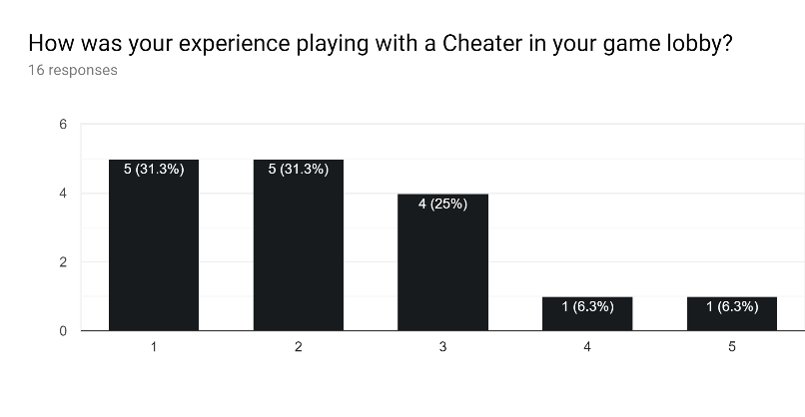
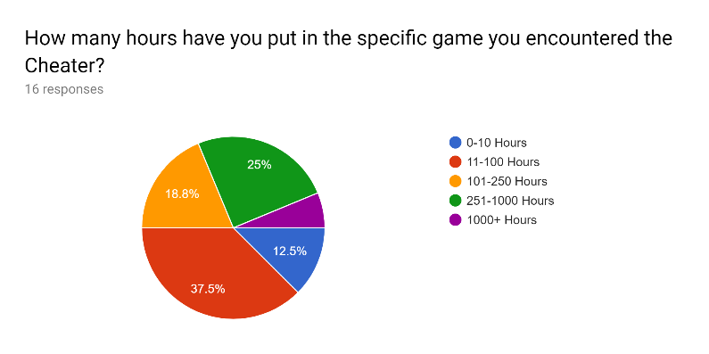
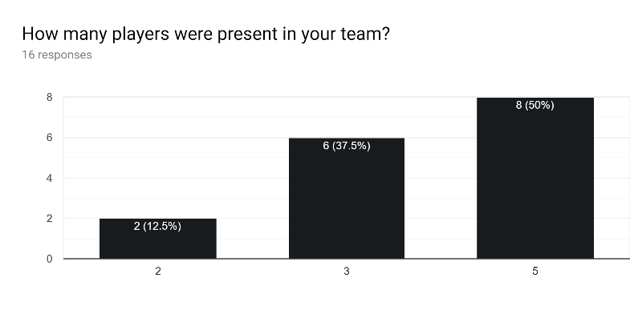
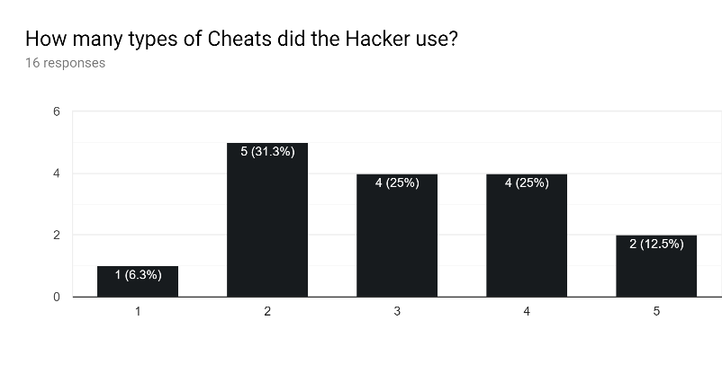
Results

Slide 23
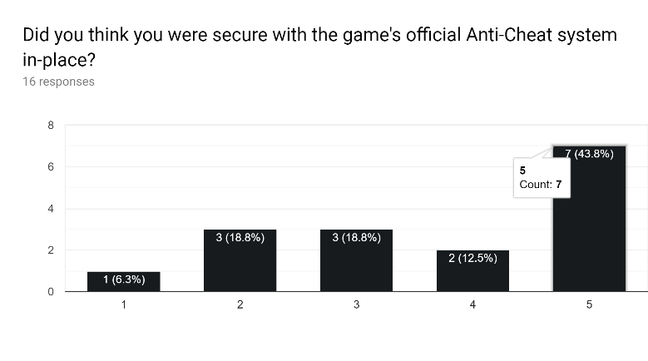
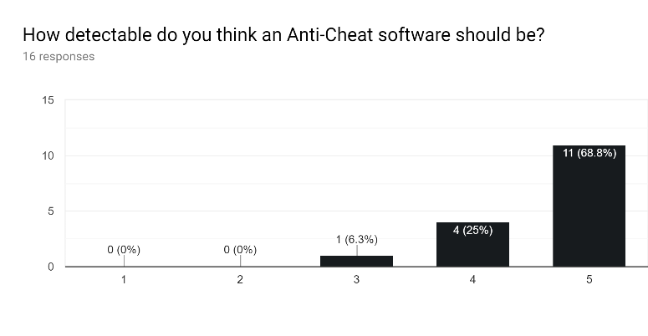
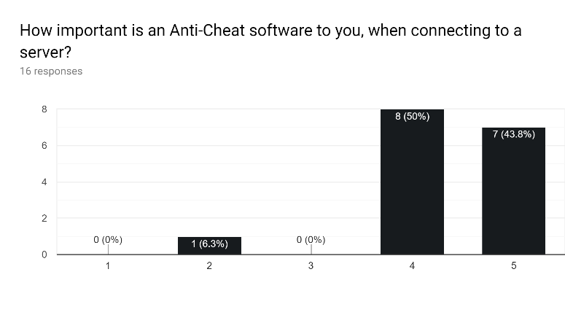
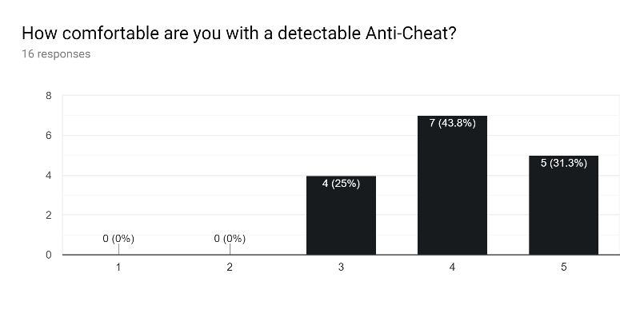
Results (Cont.)

Slide 24
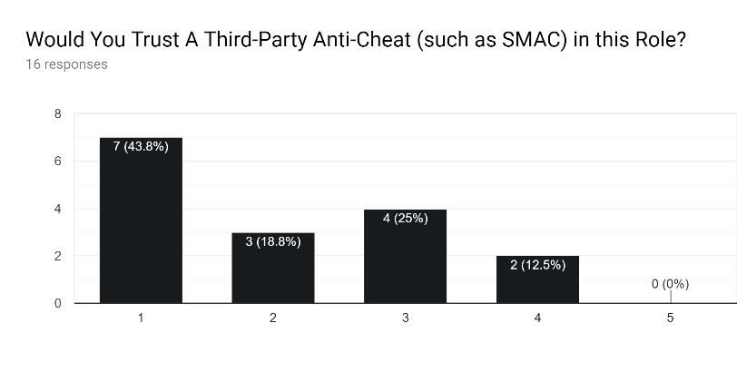
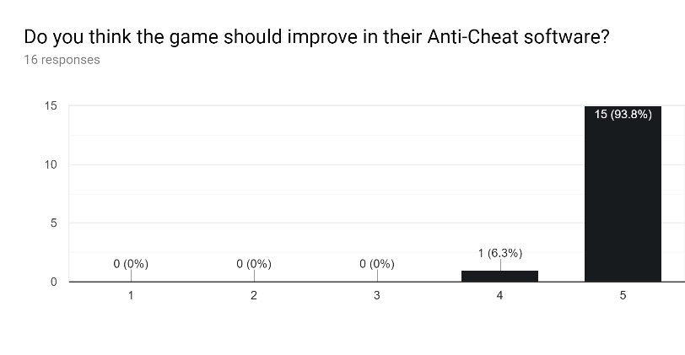
Results and Conlusion
From the responses collected from the questionnaire we can analyze and conclude the following: -
Players most did not enjoy playing in the same lobby as a cheat and it mostly ruined this experience.
The questionnaire was a success since all the participants agreed to take time and fill out the survey.
Most players who participated have put 11-100 hours in the respected game.
They analyzed mostly 5 cheats, which shows how much players understand the types of cheats.
Most of their responses were accurate and some of them were spot on.
The majority thought there were secure with the game’s official Anti-Cheat system (VAC/EAC).

Slide 25
Conclusion (Cont.)
It is important to a big part of the players that there is an Anti-Cheat system in place, thus wanting to play fairly and as intended by the developers.
The respondents all strongly agreed that an Anti-Cheat software should be as detectable as it can. Shows us room for improvement.
More than half of the players thought they were secure while playing on official competitive servers under the Anti-Cheat systems in place.
The players felt that Anti-Cheat software are very important to them and they would like to see it improved somehow.
With no surprise, all the players were comfortable with an Anti-Cheat software in-place.
When asked if Source Mod Anti-Cheat were to launch an updated Anti-Cheat that would publicly-available releases, about how SMAC can access your potentially sensitive files, ease their concerns, they mostly didn’t mind and trust the confidentiality of their files with an Anti-Cheat software.
The respondents mostly trust a Third-Party software (SMAC) to have availability to their files.

Slide 26
Conclusion (Cont.)
In conclusion, they all felt that the games could improve their Anti-Cheat system by Cheat Detection while establishing a connection to the server, put more emphasis in the Anti-Cheat security team, blacklisting hackers with EAC instead of using a Third-Party to do so (such as SMAC), analyze how players track other players as well as monitor their movement and speed, possibly lean from other Anti-Cheat systems and share resources and finally change the Anti-Cheat system if it the hackers are always one step ahead.

Slide 27
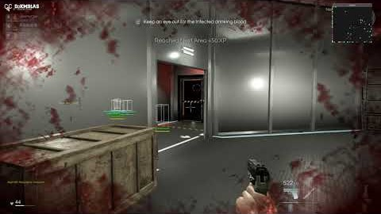
Deceit Hack Lobby #1
Vid. 1. A full match where I used multiple hacks for Deceit prior to the questionnaire.

Slide 28
References
Quidditch. (n.d.). Retrieved June 15, 2019, from Pottermore website: https://www.pottermore.com/collection/quidditch
Consalvo, Mia (2007). "Chapter 5". Cheating: gaining advantage in videogames. MIT Press. pp. 114–115
Imgur. (n.d.). My 180hr Witcher 3 glitch adventure (visual guide). Retrieved June 15, 2019, from Imgur website: https://imgur.com/gallery/9Vbbs
Insane spam of golden cookies. (n.d.). Retrieved June 15, 2019, from DashNet Forums website: https://forum.dashnet.org/discussion/16244/insane-spam-of-golden-cookies
HAUPTNER. (n.d.). Dead by Daylight new Cheat [fly, noclip, give item]. Retrieved from https://www.youtube.com/watch?v=UhJkM3tGGVw
BazingaHackerTV. (n.d.). Fly In fortnite glitch? WTF no HACK no MOD. Retrieved from https://www.youtube.com/watch?v=49PquW5Szgo
Portal 2 · AppID: 620 · Steam Database. (n.d.). Retrieved June 15, 2019, from https://steamdb.info/app/620/
Steam, The Ultimate Online Game Platform. (n.d.). Retrieved June 15, 2019, from https://store.steampowered.com/about/
Just Cause 4 · AppID: 517630. (n.d.). Retrieved June 15, 2019, from Steam Database website: https://steamdb.info/app/517630/
[WTS] R6 Boosting | Top 100 Global | Cheap | Self Play | Cheater - MPGH - MultiPlayer Game Hacking & Cheats. (n.d.). Retrieved June 15, 2019, from https://www.mpgh.net/forum/showthread.php?t=1330501&highlight=wts
Undetected Cheats for CSGO, PUBG, COD, GTA, BF and many more | AIMWARE.net. (n.d.). Retrieved June 15, 2019, from https://aimware.net/
Competitive play - Official TF2 Wiki | Official Team Fortress Wiki. (n.d.). Retrieved June 15, 2019, from https://wiki.teamfortress.com/wiki/Competitive_play
LMAOBOX Project - Feature List. (n.d.). Retrieved June 15, 2019, from https://lmaobox.net/features
Valve Anti-Cheat System (VAC) - Valve Anti-Cheat (VAC) System - Knowledge Base - Steam Support. (n.d.). Retrieved June 15, 2019, from https://support.steampowered.com/kb/7849-RADZ-6869/
start [SourceMod Anti-Cheat]. (n.d.). Retrieved June 15, 2019, from http://web.archive.org/web/20150521190758/http:/smac.sx/wiki/doku.php
DoKM91AS (n.d.). 2019 05 30 10 11 14. Retrieved from https://www.youtube.com/watch?v=4uPAKXje7DI&feature=youtu.be
The Effect of Cheats in Anti-Cheat Protected Servers/Games. (A.M.). Retrieved June 15, 2019, from Google Docs website: https://forms.gle/q6uv4ehXsA66L5Fp6

